Slide 1


Slide 2
SM - System Maintenance – They are used by Basis Consultant
SE – System Engineering – TCODES which we will use
ST – System Tools – Both depending on need

Slide 3
TODO: Provide the list of TCodes important for BASIS work

Slide 4
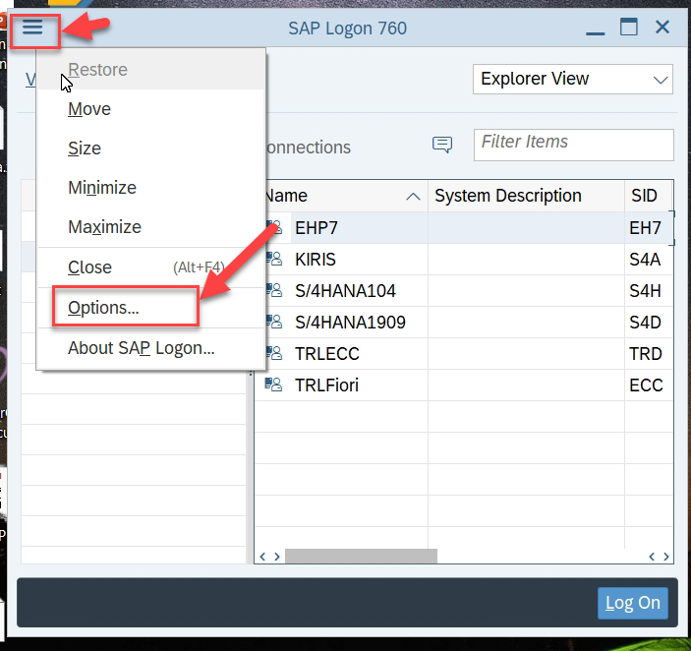
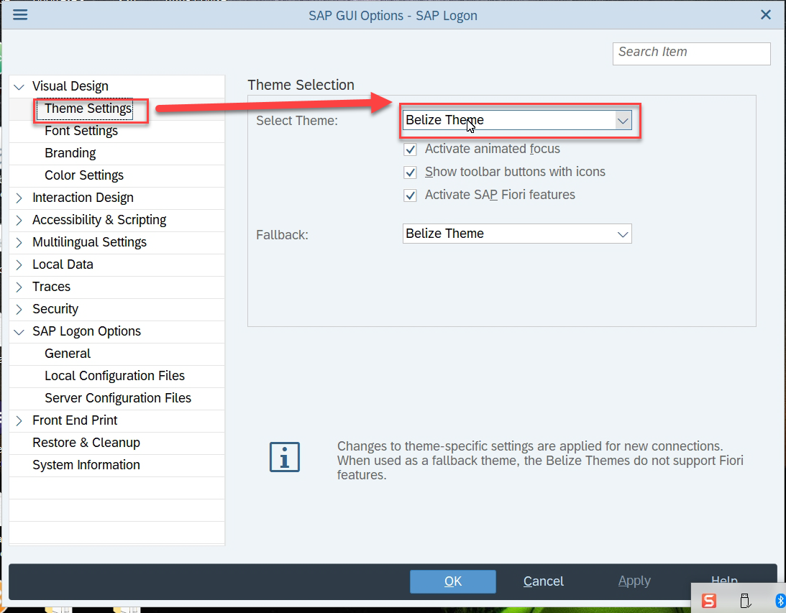
Click on More Option icon on top left and choose options
13 Select Theme Settings and Select Theme Dropdown

Slide 5
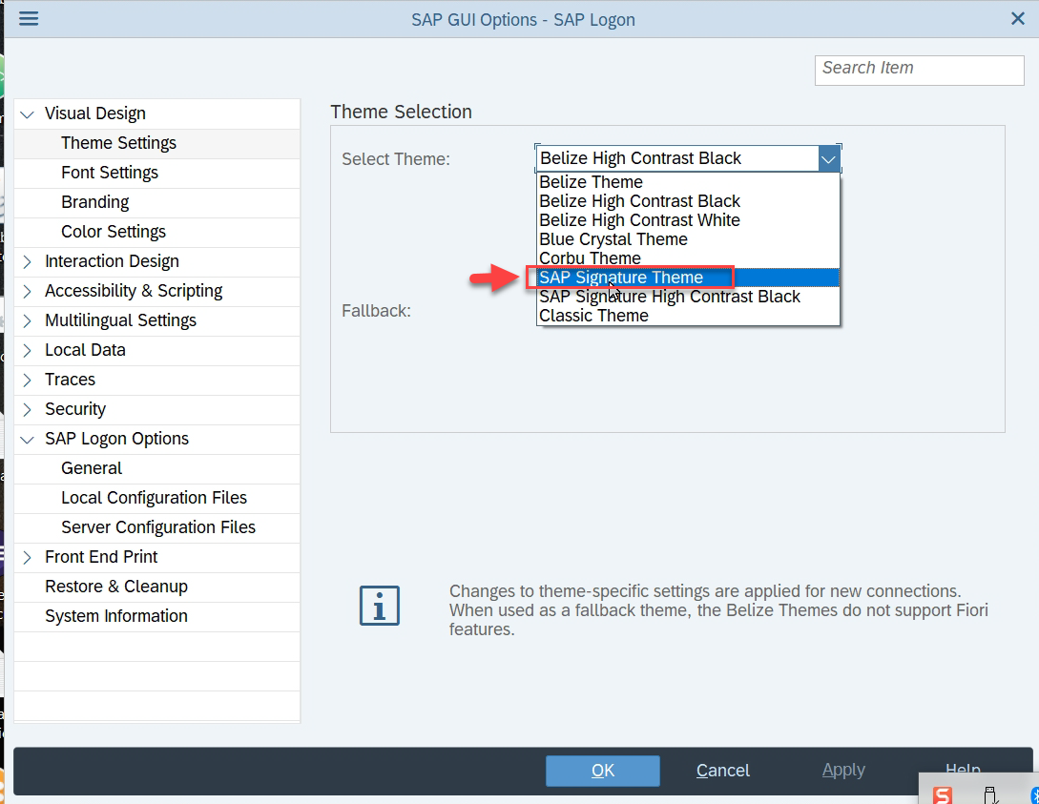
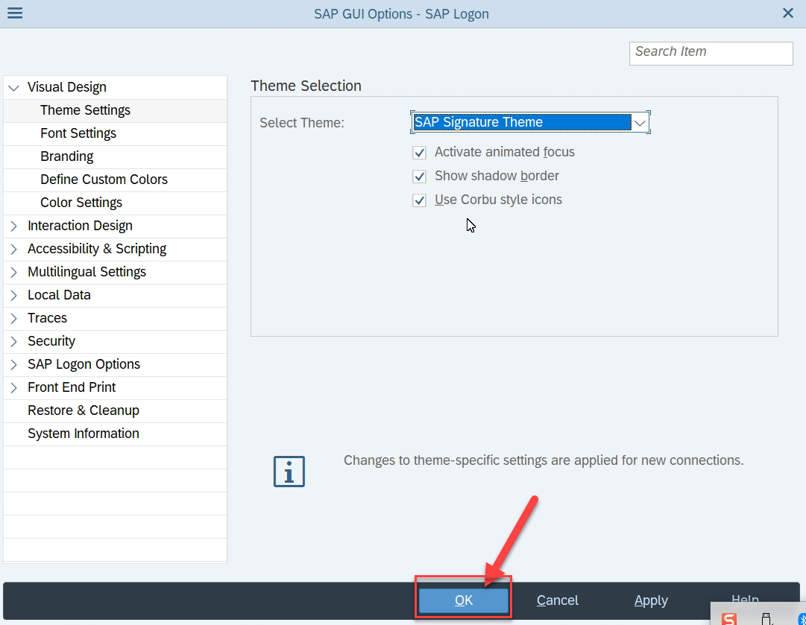
14. Change Theme to SAP Signature Theme
15. Click Ok and Restart SAPGUI again

Slide 6
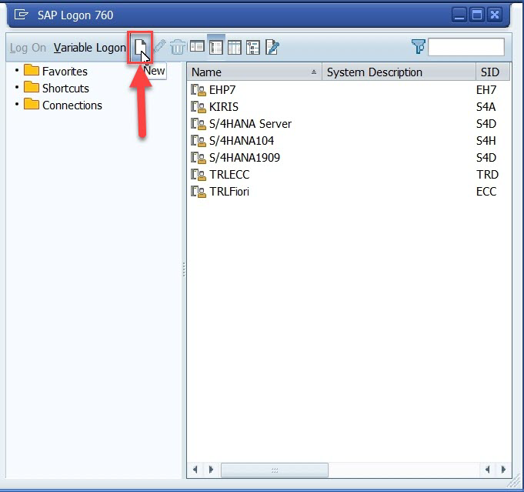
16. Now we click on Add New System

Slide 12
Find Release information
https://help.sap.com/viewer/product/SAP_S4HANA_ON-PREMISE/2020/en-US?task=discover_task
DBACOCKPIT – To check Which are all the DB SAP Application layer is connected to.
Why Package?
Grouping of our Development objects
If we want our Object to be Sent to Q and P system, we must have to have a package
If we don’t assign package to a development object, SYSTEM WILL NOT ASK FOR TRANSPORT REQUEST
Objects which a developer creates for Learning and Testing purpose and don’t want to deliver should be KEPT LOCAL which is a default package called $TMP
DEV
Q
P
Q
P
Q
P

Slide 15
Master Data – Is a data which never changes. If at all changes, it changes very seldomly. E.g. CUSTOMER, PARTNER, SUPPLIER.
LEDGER, EMPLOYEE
Transaction Data – Changes very frequently. Like orders, contracts, policies, LDR Entries. A transaction is always created against master data.
Org Data – NEVER. Like Cost Center, Profit Center, Plant. - Mandatory

Slide 16
Buffering

Slide 18
1. Enter data element name ZDTE_XX_EMPID
2. Double Click on it
3. Click yes to create new
4. Provide Description and click Save
5. Select your package and Transport
6. Click on Documentation and Select Yes
7. Maintain some text and MUST Activate the same
8. Back and Now enter field labels
5 EmpID
10 Emp Id
15 Employee ID
20 Employee ID
9. Go to Data Type Tab and enter a Domain Name
ZDO_00_EMPID
and Double Click
10. Click Create
11. Enter Description and Enter Field Type INT1 (Similar to what we earlier had)
12. Save and Activate
13. Back to Data Element
14. Save and Activate
15. Save and Activate Table

Slide 19
Exercise
Create all the data elements and domain - ZNC_EMP_00
Create a new DB Table for department - ZNC_DEPT_00

Slide 21
Exercise
Pick one order from SNWD_SO table, Copy NODE_KEY
Check Items of that Order in SNWD_SO_I table by passing PARENT_KEY
Copy the PRODUCT_GUID of an Item and pass that to NODE_KEY or SNWD_PD (product table)
Copt the DESCRIPTION_GUID of the product and pass that to PARENT_KEY of the SNWD_TEXTS table to check name of the product
Copy the SUPPLIER_GUID from SNWD_PD table and check who is the supplier of that product in SNWD_BPA table by passing the copied ID to NODE_KEY

